Slide 1
SEAD3443-Introduction to Data Science
Dr. Abdullah Yousafzai

Slide 2
Instructor
DR ABDULLAH YOUSAFZAI
Associate Professor, Faculty of IT
Post Doctorate (Blockchain and Federated Learning)
Kyung Hee University, South Korea.
PhD (Computer Science)
Distributed Systems (Mobile Computing)
University of Malaya, Kuala Lumpur, Malaysia.
MS (Computer Science)
Distributed Systems (Content Delivery Networks)
CUI Abbottabad
BS (Computer Science)
Hazara University, Mansehra.
abdullah.yousafzai@ucp.edu.pk

Slide 3
Our Objective at UCP
UCP’s Vision
To become an internationally acclaimed University in teaching and research.
UCP’s Mission
To provide quality education leading to research, employability and entrepreneurial pursuits creating societal impact, serving the nation and the world.
BSSE -- PEOs
PEO 1– Contribute effectively to software development industry by the application of requisite technical skills.
PEO 2– Demonstrate advancement in the field of software engineering by enhancing their knowledge and skills.
PEO 3– Demonstrate ethical values and contribute positively towards the society.

Slide 4
UCP Core Values
Integrity: We put honesty and ethical responsibility at the core of everything we do.
Respect: We treat everyone with dignity and value the wisdom and expertise of the people that surround us.
Tolerance: We accept the existence of different views, ideas, and people even if we may disagree with them.
Commitment: We are passionate and determined to work hard in order to achieve our goals.
Service: We believe in helping our community and working together to empower each other.
Creativity: We celebrate innovation and encourage new ways to think.

Slide 5
Course Methodology
Lectures
16 power point lectures
Study relevant sections of Text/Ref books
Assignments
Assignment should done on individual basis
To be submitted exactly when due according to the direction.
10% marks deduction per day for being late.
No submission after 5 days (120 hours).
Quizzes
Un-announced.
No make-up for quizzes
Exam Pattern
Exams to include complete material in covered chapters
MCQs, short answers, problems, design questions

Slide 6
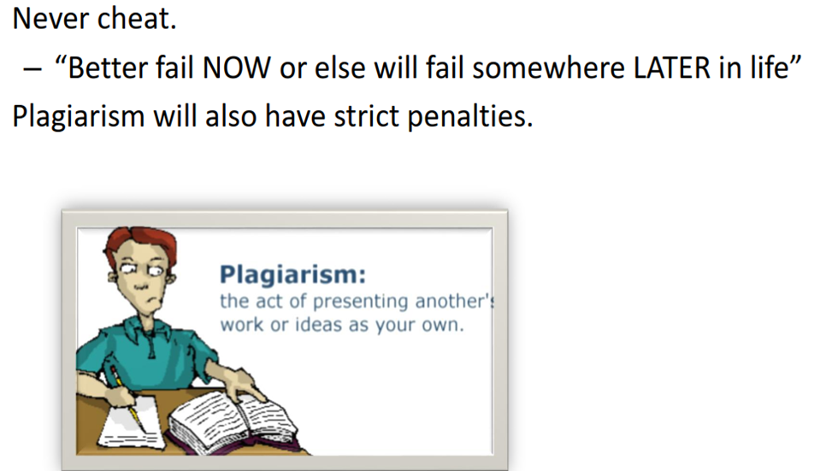
Academic Honesty
Your work in this class must be your own
If students are found to have:
collaborated excessively, or
copied/shared answers
For the first infraction…
all involved will, at a min,
receive grades of 0
Further infractions…
will result in failure in course

Slide 7
Classroom Etiquettes
Attendance policy strictly in accordance with the Univ policy.
If you come 10 – 20 minutes late, you will be marked late – no relaxation.
If you come after 20 minutes, you will be marked absent – no relaxation.
Bring your own devices, equipment's and stationary.
Usage of Mobile phones is strictly prohibited in the class, keep it silent or switched off.(Receiving a phone call will be penalized in CP).
Everyone must come with a copy and pen to record his notes.
No disturbance!!!! No Misconduct!!!!
If you do not understand a point, raise your hand and ask me to explain or contact during counselling hours.
REMEMBER: Your first priority must be your studies

Slide 8
Administrative Information
Office : Cabin 16, Gym Building.
Counselling Hours : 12:55-13:55 (Tuesday)
Email : abdullah.yousafzai@ucp.edu.pk.
Phone, I generally prefer to communicate on emails so if you found my number don’t call/message.
Prior appointment is mandatory for coming to my office during counselling hours.
Saturday & Sunday is OFF, so no one will be entertained on OFF days.

Slide 9
Grading Policy
Quizzes (Average of all) 06 20%
Assignments (Average of all) 04 10%
Project 10%
Mid-exam ..….…. 20%
Final-exam .……… 35%
Class participation ..….…. 05%
Class Participation means how much you adhere to behavioral conduct (noise making, murmuring).
This will be monitored/recorded for each student.
Distribution is tentative and flexible

Slide 10
Course Learning Outcomes
 |  | Domain | BT Level
CLO: 1 | Explain basic concepts of data science, statistics, probability and their application in understanding behavior of data. | C | 2
CLO: 2 | Simulate data science steps in python. | C | 3
CLO: 3 | Apply basic tools for performing exploratory data analysis and visualization. | C | 3
CLO: 4 | Examine basic predictive modeling and data analysis methods | C | 4
Textbook | Introduction to Data Science by Steffen Herbold. Introduction to Data Mining by Tan, Steinbach, Kumar.
Reference Material | Introduction to data science: Data analysis and prediction algorithms with R. by Irizarry, Rafael A.

Slide 12
Chapter 01
Introduction

Slide 13
Outline
Introduction to Big Data
Data Science and Business Intelligence
The Skillset of Data Scientists
Summary

Slide 14


What is „Big Data“?!?
Is this really about size?

Slide 15
Naive Definition
Naive definition:
Big data only depends on the data size
1 Gigabyte? 1 Terabyte? 1 Petabyte?
Naive interpretation misses important aspects
Time:
Analyzing 1 Gigabyte of data per day is different from analyzing 1 Gigabyte of data per second
Diversity:
Analyzing spread sheets with numeric data is different from analyzing Web pages that contain a mixture of text and images
Distribution:
Analyzing data from a single source is different from analyzing data from multiple sources

Slide 16


Definition of Big Data
Following Gartner‘s IT Glossary:
Big data is high-volume, high-velocity and/or high-variety information assets that demand cost-effective, innovative forms of information processing that enable enhanced insight, decision making, and process automation.
The three Vs
Volume
Velocity
Variety
Some people actually use 10 Vs to define big data!
Variability
Veracity
Validity
Vulnerability
Volatility
Visualization
Value

Slide 17
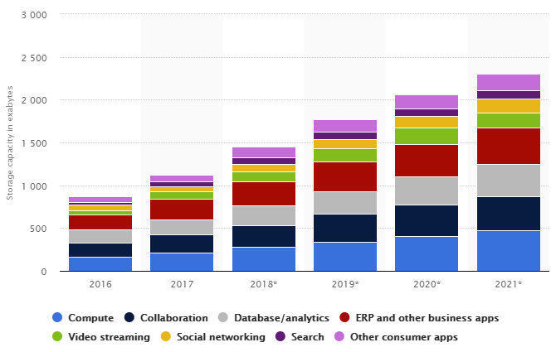
The 3 Vs: Volume
Scale of the data must be „big“
No clear definition
„that demand […] innovative forms of information processing“ (Gartner)
Data center storage worldwide
© Statista 2018

Slide 18

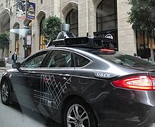

The 3 Vs: Velocity
Speed at which new data is created
Speed at which data must be processed and analyzed
Often close to real-time

Slide 19
The 3 Vs: Variety
Diversity in data types and data sources
Structured
Semi-Structured
Quasi-Structured
Unstructured
Data with defined types and structure
Example: comma separated values
Textual data with parseable pattern
Example: XML files with schema
Textual data with erratic formats that can be formated with effort
Example: Clickstream data
Data that has no inherent structure, often with multiple formats
Example: Web site, videos

Slide 20
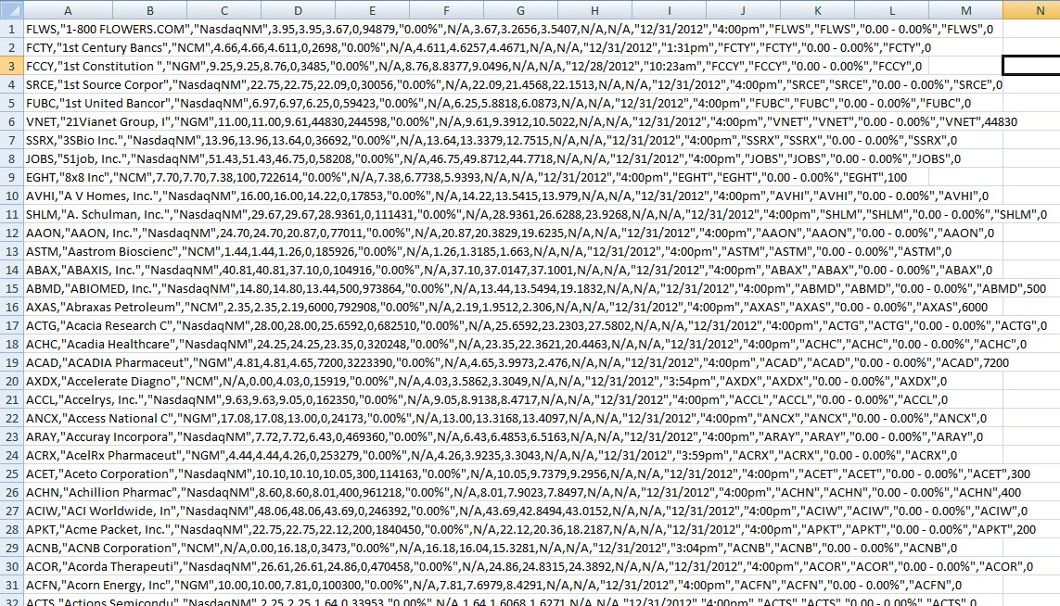
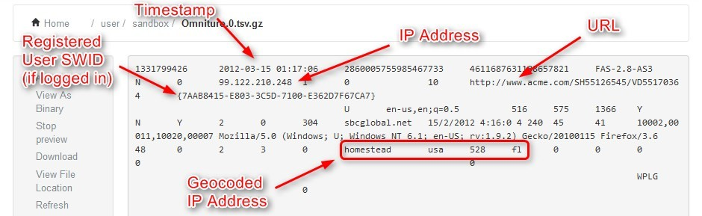
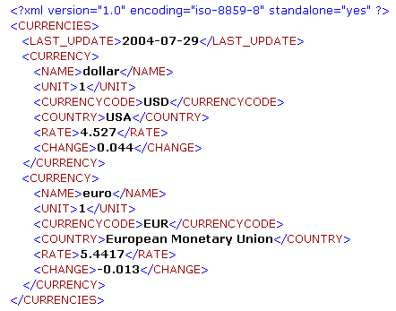
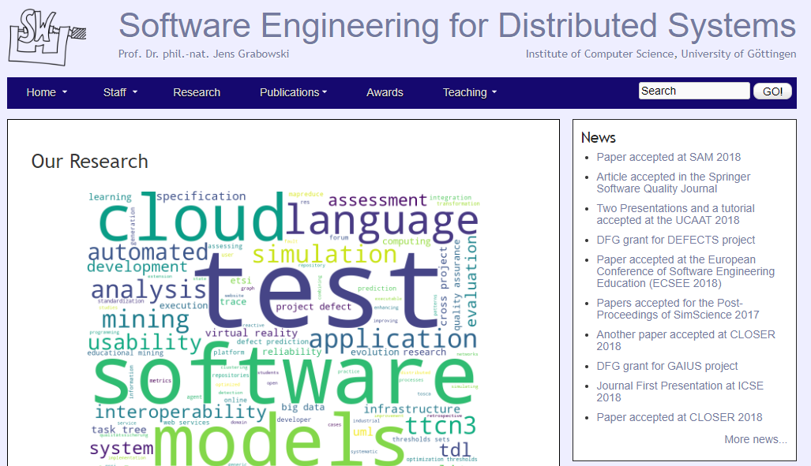
Examples for data types
Structured
Quasi-Structured
Semi-Structured
Unstructured

Slide 21
Outline
Introduction to Big Data
Data Science and Business Intelligence
The Skillset of Data Scientists
Summary

Slide 22
Defining Data Science
Unfortunately, there is no clear definition (yet?)
Goal is the extraction of knowledge from data
Combination of techniques from different disciplines
Scientific principles guide the data analysis

Slide 23

What is „Data Science“?!?
Confluence of Multiple Technologies
Tools? Big Data? Machine Learning?

Slide 24
Mathematical Aspects
Computational Geometry
Optimization
Stochastics
Machine Learning
Scientific Computing

Slide 25
Computer Science Aspects
Data Structures and Algorithms
Databases
Distributed Computing
Software Engineering
Artificial Intelligence
Machine Learning

Slide 26
Statistical Aspects
Linear Models
Statistical Tests
Inference
Time Series Analysis
Machine Learning

Slide 27
Applications
Intelligent Systems
Robotics
Marketing
Social Networks
Medicine
Autonomous Driving

Slide 28
Data Science vs. Business Intelligence
Business Intelligence (Gartner IT Glossary)
[…] best practices that enable access to and analysis of information to improve and optimize decisions and performance.
High
 | Business Intelligence | Data Science
Techniques | Dashboards, alerts, queries | Optimization, predictive modelling, forecasting
Data Types | Structured, data warehouses | Any kind, often unstructured
Common questions | What happened…? How much did…? When did…? | What if…? What will…? How can we…?
Depth of Insights
Data Science
Business Intelligence
Low
Past
Present
Future
Time

Slide 29




















More Data → More Opportunities
TERABYTES
PETABYTES
EXABYTES
LARGE
VOLUME OF INFORMATION
SMALL
1990’s
Relational Databases & Data Warehouses
2000’s
Content Management
2010’s
Key-Value Storages
& Unstructured Data

Slide 30
Outline
Introduction to Big Data
Data Science and Business Intelligence
The Skillset of Data Scientists
Summary

Slide 31
What are Data Scientists?
Not computer scientists
But should know about databases, data structures, algorithms, etc.
Not mathematicians
But should know about optimization, stochastics, etc.
Not statisticians
But should know about regression, statistical tests, etc.
Not domain experts
But must work together with them

Slide 32
Skills of Data Scientists
Data Scientists
Quantitative
Skeptical
Collaborative
Technical
Programming
Infrastructures
Maths
Algorithms
Create hypotheses, but be skeptical about them
Teamwork
Communication skills
Statistics
A bit of everything
… but actually as much as possible of everything

Slide 33
Different types of Data Scientists
Data Analyzer
Analyzing data
Platform Builder
Collect data and create infrastructures
Moonlighters
„Spare time“ data scientists
Insight Actors
Use the outcome and act on insights.
According to Microsoft Research:
Polymath
„Do it all“
Data Evangelist
Data analysis, disseminating and acting on insights
Data Preparer
Querying existing data, preparing data for analysis
Data Shapers
Analyzing and preparing data
Miyung Kim, Thomas Zimmermann, Robert DeLine, Andrew Begel: Data Scientists in Software Teams: State of the Art and Challenges, IEEE Transactions on Software Engineering (Online First)

Slide 34
Why data science?
Scientific point of view
Scientists are at an unprecedented position where they can collect EBs of information
Examples: Sensor data, astronomy data, social network data, gene data
We need the tools to analyze such data to get a better understanding of the world and advance science and help people
Commercial point of view
Data has become the key competitive advantage of companies
Examples: Facebook, Google, Amazon
Being able to extract useful information out of the data is key for exploiting them commercially.
Scale (in data size and feature dimension)
Why not use traditional analytic methods?
Enormity of data, curse of dimensionality
The amount and the complexity of data does not allow for manual processing of the data. We need automated techniques.
“Data is the new oil”
Notes:
Social point of view

Slide 35
Why data science?
The industry point of view: The analysis of huge amounts of data for extracting useful and actionable information, which is then integrated into production systems in the form of new features of products
Data Scientists should be good at data analysis, math, statistics, but also be able to code with huge amounts of data and use the extracted information to build products.

Slide 36
In the Data science ERA
Boundaries are becoming less clear
Today data science, data mining, machine learning and AI are becoming synonymous.
It is assumed that the algorithms should scale. It is clear that statistical inference is used for building the models. Data is the engine for AI

Slide 37
Outline
Introduction to Big Data
Data Science and Business Intelligence
The Skillset of Data Scientists
Summary

Slide 38
Summary
Big data has a high volume, velocity, and variety
Different data structures
Structured, semi-structured, quasi-structured, unstructured
Data science is a very diverse discipline
Maths, computer science, statistics, applications
→ Data scientists require a diverse skillset

Slide 39
Course Organization
The Process of Data Science Projects
Data Exploration
Overview of Data Analysis
Association Rules
Clustering
Classification
Regression
Time Series Analysis
Text Mining
Statistics
Big Data Processing's
Modules
(Slight Changes in the Order of Modules is expected)

Slide 40
Chapter 02
Process of Data Science Projects

Slide 41
Outline
Generic Process Model
Roles
Core Deliverables
Summary

Slide 42
Processes are Important
Techniques
Languages, tools, and methods
Must be suited for the given problem
People
Require training for the techniques
Should be guided through a project by a process
Process
Supports the people
Must be accepted by the people
Should have a measurable positive effect
Techniques
People
Processes

Slide 43
Process of Data Science Projects
Discovery
Operationalize
Data
Preparation
Communicate Results
Model Planning
Model Building

Slide 44
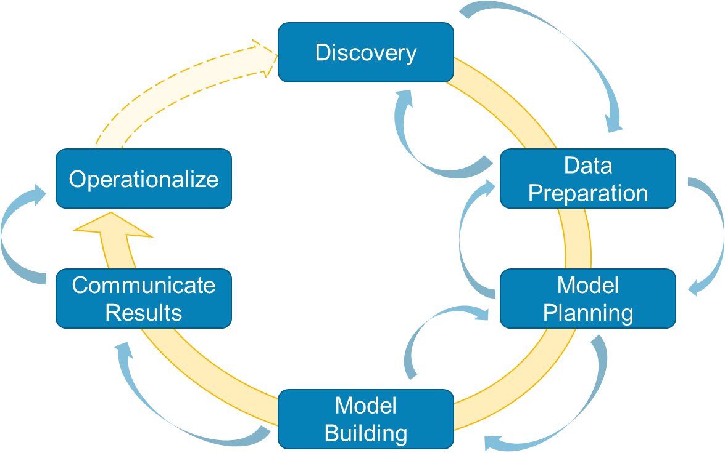
Discovery
Initial phase of the project
Learn the domain
Knowledge for understanding the data and the use cases of the project
Knowledge for the interpretation of the results
Learn from the past
Identify past projects on similar issues
Differences, reasons for failures, weaknesses of past projects
Can also be projects of competitors, if reports are available

Slide 45
Discovery
Frame the problem
Framing is the process of stating the data analysis problem to be solved
Why is the problem important?
Who are the key stakeholders and what are their interests in the project?
What is the current situation and what are pain points that motivate the project?
What are the objectives of the project?
Business needs
Research goals
What needs to be done to achieve the objectives?
What are success criteria for the project?
What are risks for the project?

Slide 46
Discovery
Begin learning the data
Get a high-level understanding of the data
Maybe even some initial statistics or visualizations of the data
Determine requirements for data structures and tools for processing the data
Formulate hypothesis
Part of the „Science“ in „Data Science“
Should define expectations
„Feature X is well suited for the prediction of …“
„The following patterns will be found in the data: …“
„Deep learning will outperform …“
„Decision trees will perform well and allow insights into …“
Should be discussed with stakeholders
In a scientific setting, a hypothesis is meant to be proven through experimentation. In data science, a hypothesis is proven through data analytics. This means, once the hypothesis is defined, you can collect data to determine whether it provides enough evidence to support the hypothesis.

Slide 47
Discovery
Analyze available resources
Technologies
Resources for computation and storage
Licenses for analysis frameworks
Data
Is the available data sufficient for the use case?
Would other data be required and could the additional data be collected within the scope of the project?
Timeframe
Scope in calendar time and person months
Human resources
Who is available for the project?
Is the skillset a good match for the tasks of the project?
→ Only start project if the resources are sufficient!

Slide 48
Data Preparation
Create the infrastructure for the project
Usually different from infrastructure in which data is made available to you
Warehouse/csv-file/… ←→ distributed storage that enables analysis
Could also be simpler, for small data sizes
Extract – Transform – Load (ETL) the data
Define how to query existing database to extract required data
Determine required transformations of the raw data
Quality checking (e.g., filtering of missing data, implausible data)
Structuring (e.g., for unstructured data, differences in data structures)
Conversions (e.g., timestamps, character encodings)
Load the data into your analysis environment
Data transformation is the process of converting the format or structure of data so it’s compatible with the system where it’s stored.
Data transformation includes procedures such as filtering, summarizing, and formatting data. It can be done manually, automatedly, or handled with a combination of the two.

Slide 49
Data Preparation
ELT vs. ETL
Transformations can be very time-consuming for big data
Might not be possible without using the analysis infrastructure
Load raw data, transform afterwards → ELT!
This allows more flexibility with transformations
E.g., testing the effect of different transformations

Slide 50
Data Preparation
Get a deep understanding of the data
Understand all data sources
E.g., what does each column in a relational database contain?
How can a structure be imposed on semi-/quasi-/unstructured data?
Survey and visualize data
Descriptive statistics
Correlation analysis
Visualizations like histograms, density plots, pair-wise plots, etc.
Clean and normalize data
Discard data that is not required
Normalize to remove scale effects

Slide 51
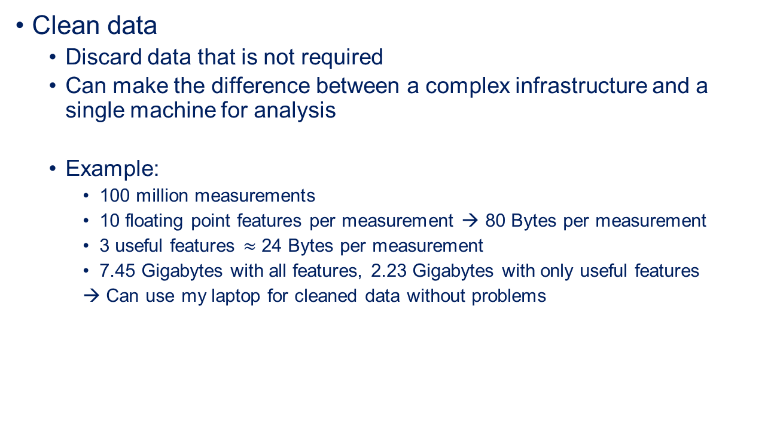
Data Preparation
Clean data
Discard data that is not required
Can make the difference between a complex infrastructure and a single machine for analysis
Example:
100 million measurements
10 floating point features per measurement → 80 Bytes per measurement
3 useful features $≈$ 24 Bytes per measurement
7.45 Gigabytes with all features, 2.23 Gigabytes with only useful features
→ Can use my laptop for cleaned data without problems

Slide 52
Model Planning
Determine methods for data analysis
Should be well-suited to meet objectives
Often determines the type of method
Classification, regression, clustering, association mining, …
Other factors can also restrict the available methods
For example, if insight is important, „blackbox“ methods cannot be used
Should be well-suited for the available data
Volume, structure, …

Slide 53
Model Planning
Methods for data analysis may cover
Feature modeling, e.g., for text mining
Feature selection, e.g., based on information gain, correlations, etc.
Model creation, e.g., different models that may address the use case
Statistical methods, e.g., for the comparison of results
Visualizations, e.g., for the presentation of results
Split data into different data sets
Training data, validation data, test data
„Toy“ data for local use in case of big data
Same structure, but very small

Slide 54
Model Building
Perform the analysis using the planned methods
Often iterative process!
Separate phase, because this can be VERY time consuming
Use toy examples for model planning
Use real big data set with potentially lots of hyper parameters for tuning during model building
Includes the calculation of performance indicators

Slide 55
Communicate Results
Main question: Was the project successful?
Compare results to hypothesis from the discovery phase
Identify the key findings
Try to quantify the value of your results
Business value, e.g., the expected Return On Investment (ROI)
Advancement of the state of the art
Summarize findings for different audiences

Slide 56
Operationalize
Implement results in operation
Only in case of successful projects
Should run a pilot first
Determine if expectations hold during the practical application
All kinds of reasons for failures
Rejection by users, shift in data reduces model performance, ...
Define a process to update and retrain model
Data gets older, models get outdated
Data driven models should be updated regularly
Process is required

Slide 57
Data science Process vs Data Analysis Pipeline
Discovery
Operationalize
Data
Preparation
Communicate Results
Model Planning
The data mining part is about the analytical methods and algorithms for extracting useful knowledge from the data.
Model Building
Data Collection
Data Preprocessing
Data Mining
Result
Post-processing

Slide 58
Outline
Generic Process Model
Roles
Core Deliverables
Summary

Slide 59
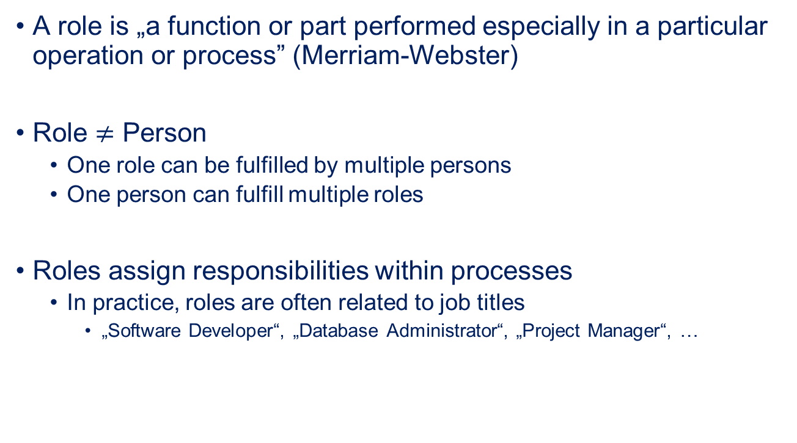
Roles within Projects
A role is „a function or part performed especially in a particular operation or process” (Merriam-Webster)
Role $≠$ Person
One role can be fulfilled by multiple persons
One person can fulfill multiple roles
Roles assign responsibilities within processes
In practice, roles are often related to job titles
„Software Developer“, „Database Administrator“, „Project Manager“, …

Slide 60
Roles for Data Science Projects
Role | Description
Business User | Someone who uses the end results Can consult and advise project team on value of end results and how these will be operationalized
Project Sponsor | Responsible for the genesis of the project Generally provides the funding Gauge the value from the final outputs
Project Manager | Ensure key milestones and objectives are met on time and at expected quality Plans and manages resources
Business Intelligence Analyst | Business domain expertise with deep understanding of the data Understands reporting in the domain, e.g., Key Performance Indicators (KPIs)
Data Engineer | Deep technical skills to assist with data management and ETL/ELT
Database Administrator | Provisions and configures database environment to support the analytical needs of the project
Data Scientist | Expert on analytical techniques and data modeling Applies valid analytical techniques to given business problems Ensures analytical objectives are met

Slide 61
Outline
Generic Process Model
Roles
Core Deliverables
Summary

Slide 62
Deliverables
A deliverable is a tangible or intangible good or service produced as a result of a project.
Are often parts of contracts
Should meet stakeholder‘s needs and expectations
Four core deliverables for data science projects
Sponsor presentation
Analyst presentation
Code
Technical specifications

Slide 63
Sponsor Presentation
„Big Picture“ of the project
Clear takeaway messages
Highlight KPIs
Should aid decision making
Should address a non-technical audience
Clean and simple visualizations
For example, bar charts, line charts, …

Slide 64
Analyst Presentation
Describe analysis methods and data
General approach
Interesting insights, unexpected situations
Details on how results change current status
Business process changes
Advancement of the state of the art
May use more complex visualizations
For example, density plots, histograms, boxplots, ROC curves, …
Should still be clean and not overloaded

Slide 65
Code and Technical Specification
All available code of the project
Often code is prototypical („hacky“) because results are more important than clean code
Enables operationalization
May re-use code as is
May adopt code or clean up code
May rewrite same functionality in a different language/for a different environment
Technical specification should be provided as well
Description of the environment
Description of how to invoke code

Slide 66
Expected Deliverables by Role
Role | Deliverable
Business User | Expects a sponsor presentation: Are the results good for me? What are the benefits for me? What are the implications for me?
Project Sponsor | Expects a sponsor presentation: What is the impact of operationalizing the results? What are the risk and what is the potential ROI? How can this be evangelized within the organization (and beyond)?
Project Manager | Responsible for the timely availability of all deliverables Responsible for the sponsor presentations
Business Intelligence Analyst | Expects an analyst presentation: Which data was used? How will reporting change? How will KPIs change?
Data Engineer | Responsible for data engineering code and technical documentation
Database Administrator | Responsible for infrastructure code and technical documentation
Data Scientist | May be the target audience for analyst presentations. Responsible for data analysis code and technical documentation Responsible for the analyst presentation Support of the project management with the sponsor presentation

Slide 67
Data as Deliverable
Only applicable if new data was collected/generated
Sharing the data may be very important
Especially in research to enable reproducible and replicable research
Sharing may be internal (industry) or public (research)
Use stable links for references to prevent link rot
Ideally Digital Object Identifiers (DOIs)
Should not only contain the data, but also metadata and tools for collecting the data

Slide 68
Outline
Generic Process Model
Roles
Core Deliverables
Summary

Slide 69
Summary
Generic process for data science projects with six phases
Discovery, data preparation, model planning, model building, communication of results, and operationalization
Different actors in different roles involved in project
Expectations depend on role
Four core deliverables fulfill most stakeholder needs
Sponsor presentation, analyst presentation, code, technical specification
Data may also be a deliverable

